Slide 1
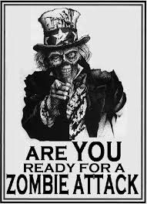
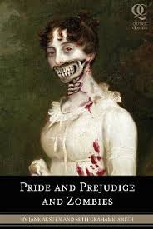
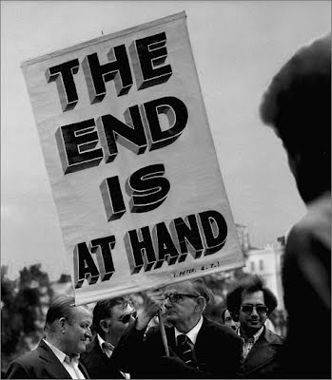
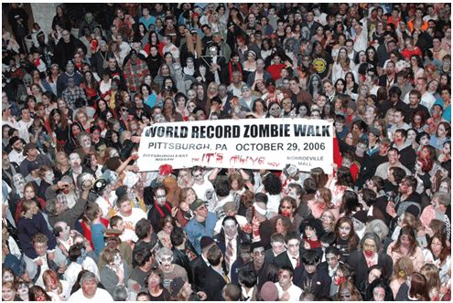
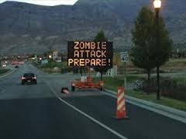
Zombies in Popular Culture

Slide 2
Zombies as Reflections of Societal Fears
Cannibalism: Endless Hunger
-classic zombie trait
Dead Returning: The Unnatural
classic zombie trait
Herd Mentality: Lack of Conscience
-modern zombie trait
Extreme Violence: Normalizing of violence
modern zombie trait

Slide 3
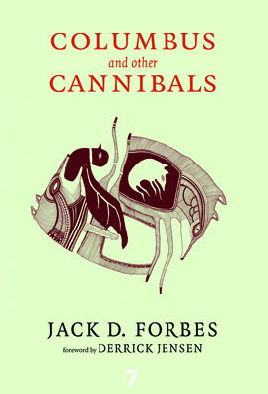
Greed as Cannibalism
Columbus and other Cannibals-
Native American author Jack Forbes
“Wetiko is a Cree term (wendigo in Ojibway, wintiko in Powhatan) which refers to a cannibal or, more specifically, to an evil person or spirit who terrorizes other creatures by means of terrible acts, including cannibalism.”
Forbes defines cannibalism as the consuming of another’s life for one’s own private purpose or profit

Slide 4
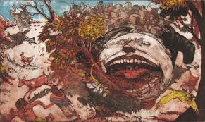
Wetiko
Notes:
-In what way can someone consume another’s life and possessions? What about metaphorically?

Slide 5
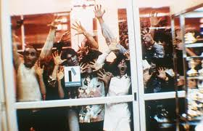
Consumers as Zombies
George Romero’s Dawn of the Dead
Zombies drool over consumer goods from outside a shopping center
-Social commentary on over-consumption
Notes:
Many of George Romero’ zombie films are social commentaries
-Do you think it makes sense to compare over-consumers to zombies?

Slide 6
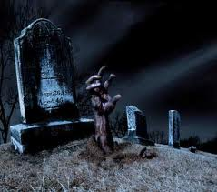
Raising the Dead

Slide 7
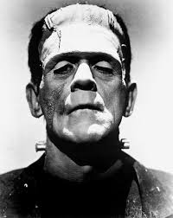
Fear of Challenging Nature?
Mary Shelly’s Frankenstein
Written in 19th century, during scientific revolution
Dr. Frankenstein creates a living monster using human body parts and electricity
Fear of scientists playing god
Notes:
-Story behind book
-Scientific advancements during 19th century: usable electricity, steel, petroleum, interchangeable parts
-Monster only becomes violent once denied human companionship
-also uncovering natural science mysteries: genetics and evolution

Slide 8
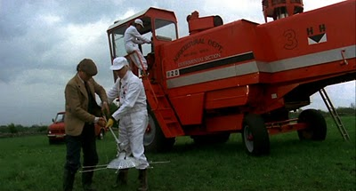
Zombies Reflect Environmental Fears
Let Sleeping Corpses Lie-Italian Film
Zombies rise from the dead because of experimental pest control machine
Notes:
-Italian film

Slide 9
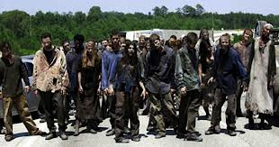
HERD MENTALITY
Symptoms:
-Loss if individuality -Lack of creativity
-Failure to question -Mindlessness

Slide 10
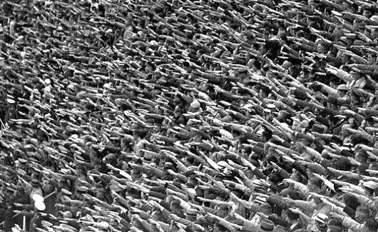
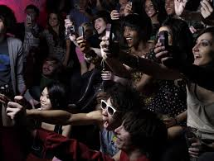
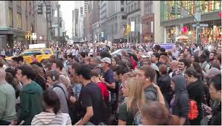
“The greatest difficulty is that men do not think enough of themselves, do not consider what it is that they are sacrificing when they follow in a herd, or when they cater for their establishment” -Emerson

Slide 11
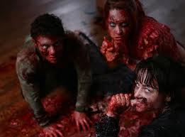
Gratuitous Violence

Slide 12
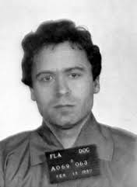
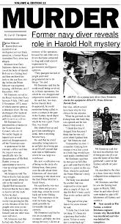
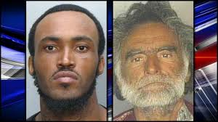
Normalizing Violence in Socity
BREAKING NEWS
Zombies reflect numbness to murders, deaths and other tragedies regularly broadcast on t.v and radio

Slide 13
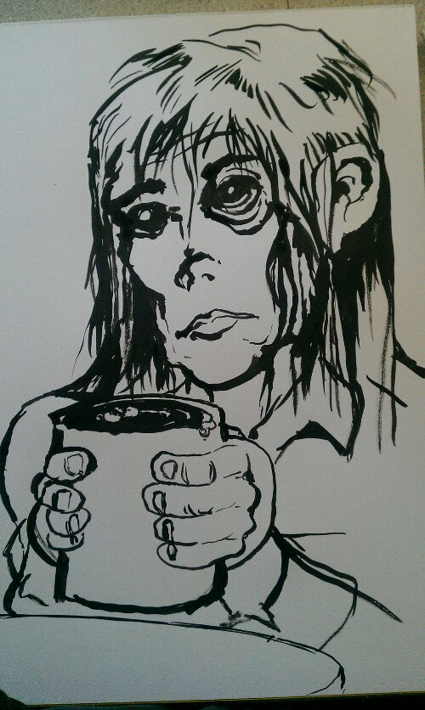
Writing Prompt: Autiobiographa-zombie
Identify your fears
Create a zombie that reflects them
Your Zombie can be:
Drawn, with labels
Written as a character
Described in bullet points
Be Creative!

