Slide 1
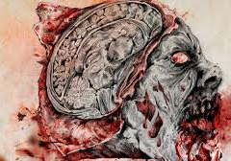
Zombie Neuroscience
Notes:
Nervous system – explanation as to why zombies behave the way that they do… also – why what happens to our physiology when being chased or being stressed.
What are you REALLY worried about? What’s real and what’s not?

Slide 2
Characteristics?
Movement?
Speech?
Demeanor?
Senses?
Diet?
Pain?
Notes:
Most of these are the result of damage to one or more aspects of the nervous system.

Slide 3
Why is this important?
Sensory input
Integration
Homeostasis
Mental activity
Control of muscles and glands
Notes:
Well, it basically controls EVERYTHING. The way we move, the way we interact with each other, aspects of our personality…
So we’re going to go over some basics about the nervous system… as far as a typical human is concerned. It’s important to understand how our nervous system is going to be affected during times of stress… and also how certain chemicals, bacteria and viruses act on the nervous system creating a Zombie like state – knowledge is power!
AND it is especially susceptible to damage. Most types of nervous tissue do not regenerate.

Slide 4
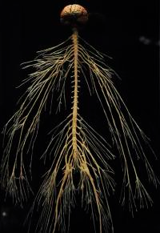
CNS
PNS
Somatic
Autonomic
Parasympathetic
Sympathetic
http://extras.mnginteractive.com/live/media/site36/2010/0310/20100310__20100312_D01_AE12BODY~p1_200.JPG
Notes:
Organization of the CNS
Brain and Spinal cord are command center
LONG NETWORK OF NERVE FIBERS – INTACT NERVOUS SYSTEM MADE UP OF A BUNCH OF NEURONS (NERVE CELLS)
Nervous system is fragile and susceptible – high fat content (toxins and diseases LOVE fatty environments, large surface area – increased blood flow to the brain.

Slide 5
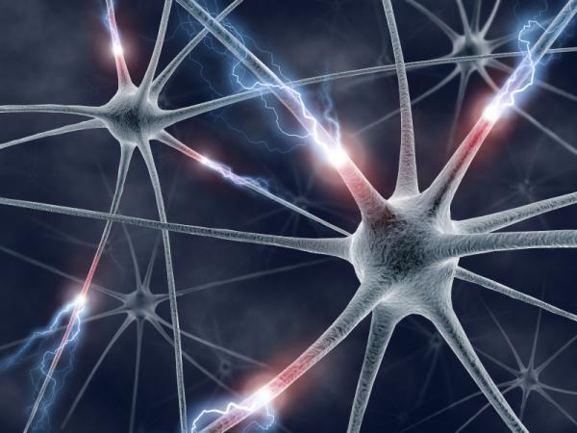
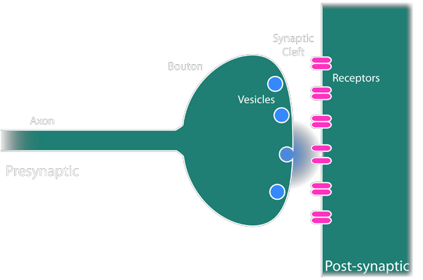
How Nerves Communicate…
Neurotransmitter
Notes:
Action potential (Na and K) – think of an action potential as an electrical current.
Neurotransmitters: Inhibitory or excitatory
Some neurotoxins and other environmental pollutants act on receptors leading to paralysis and loss of motor function.
Neurotropic viruses (rabies) – evade typical immune response : highly neuro invasive, highly neuro virulent
Most by synaptic transmission
Requires chemical messengers (a.k.a Neurotransmitters)
Inhibitory or excitatory
Acetylcholine first to be discovered
Excitatory in musculo-skeletal system
Inhibitory in cardiovascular (heart and blood vessels) system

Slide 6
Stimulus (Input) |  | Response (Output)
Skeletal muscle (Somatic Nervous System) |  |  |  | Cardiac and smooth muscle, glands (Autonomic Nervous System)
PNS | Sensory input → Action potentials from periphery to CNS |  | Motor Division conducts action potential to periphery
CNS | CNS processes and integrates info. → initiates responses and carries out mental activity
Notes:
Typical example of a nervous system response “Fight or Flight”…In times of stress: being on the run, starving, etc. Significant amounts of energy are expended on your biological functions – this leads to immune suppression – need to take in extra calories, etc.
Are the neurotransmitters excitatory or inhibitory?

Slide 7
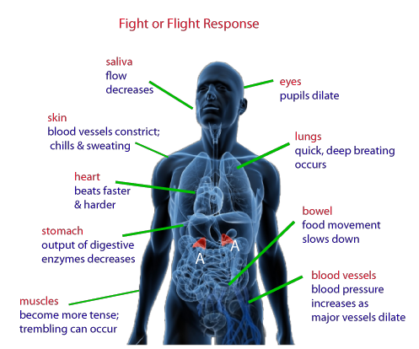
http://strengthology.net/wp-content/uploads/2013/01body_fight_flight2.png
Notes:
In order to run… some other physiological systems are activated. All begins in the amygdala

Slide 8
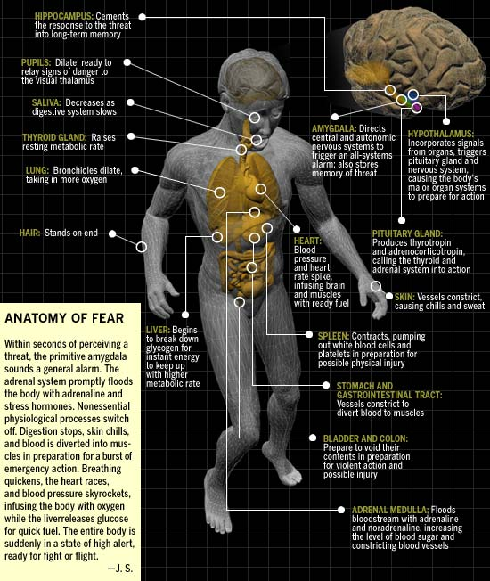

Slide 9
Neurotoxins
Disrupt signals
Infiltrate the blood brain barrier
CNS: Intellectual disability, memory impairment, epilepsy and dementia
PNS: Neuropathy, myopathy
Neurotoxin | Source | Mechanism | Symptoms | Cause of Death | Treatment
Notes:
Work by inhibiting synapses or channels or neurotransmitter production (communication between nerve cells)

Slide 10
Common Neurotoxins
Solanum
Tetrodotoxin
Botulinum toxin
Tetanus
Mercury
Aluminum
Ethanol
Arsenic
Cyanide
Notes:
Paralysis
Neuropathy
Work by inhibiting synapses or channels or neurotransmitter production
Aresenic and cyanide: Blood agents: produce neurological symptoms; but the real damage occurs within the red blood cells (important for carrying oxygen).

Slide 11
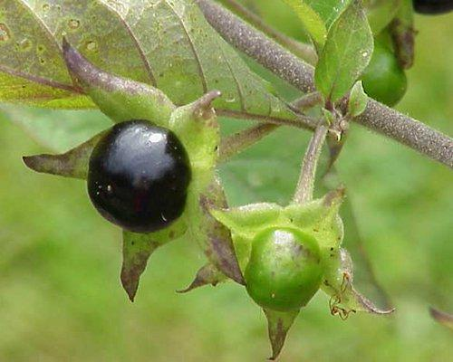
Genus: Solanum
Species: Nightshades (tomatoes, potatoes and eggplant), belladonna
SolanineToxicity: Damage to nerves of involuntary muscle (heart and blood vessels)
Disrupt K⁺ channels, failure to breakdown Ach
Quick as 30 minutes, most 8 hours
Dilated pupils, sensitivity to light, blurred vision, headaches, confusion and convulsions.
Notes:
Medicinal purposes: muscle relaxant, anti-anxiety – cure ringworm in some cultures (antifungal)
Damages cells.

Slide 12
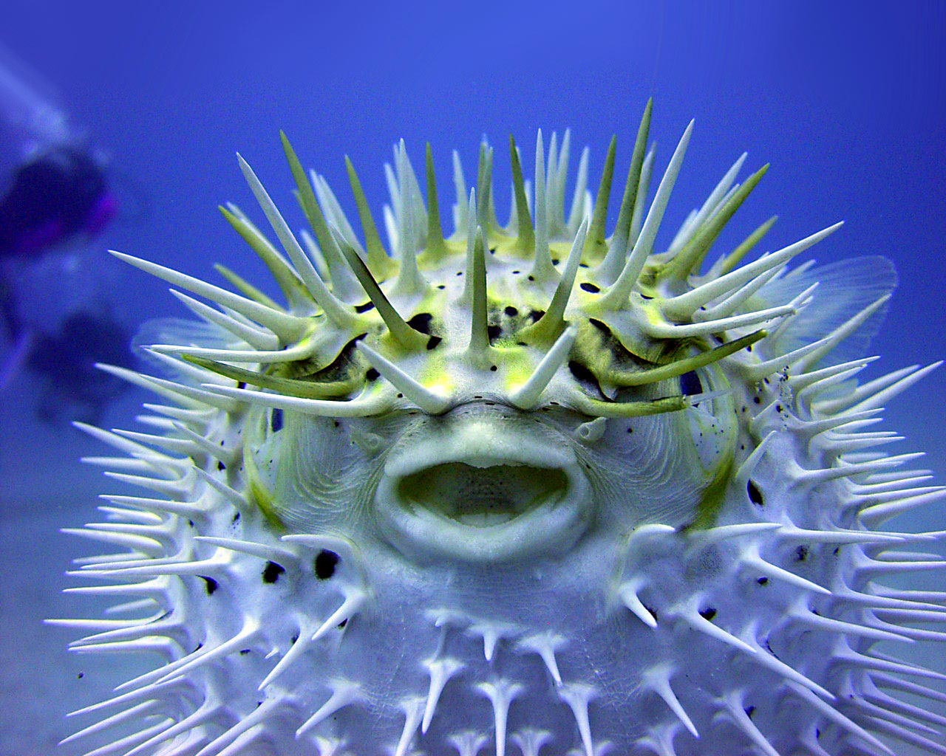
Tetrodotoxin
Source: Puffer Fish
Na Channel inhibitor
Symptoms:
15 minutes to several hours after ingestion
Paresthesia and numbness
Salivation, nausea, vomiting and diarrhea with abdominal pain
Motor dysfunction and weakness
Cardiac dysfunction (hypotension)
Coma and respiratory failure
Death can occur in as little as 4-6 hours
Notes:
Cause of death: Respiratory failure

Slide 13
Botulinum Toxin
From the bacteria: Clostridium botulinum
Found on plants, in soil, in water and in the intestinal tracts of animals
Due to improper canning or preparation of food
Acetylcholine inhibitor
Notes:
Class A threat as far as global terrorist attack.
Acetylcholine – neurotransmitter responsible for skeletal muscle contraction; without it – end up with muscle weakness.

Slide 14
Botulism: Symptoms
Appear in 24-72 hours and last 8-12 weeks
double vision
blurred vision
drooping eyelids
slurred speech
difficulty swallowing
dry mouth
muscle weakness
Notes:
Cause of death: respiratory failure

Slide 15
Tetanus
Clostridium tetani (bacteria)
Hot, damp climates with manure-treated soils. Can be found on skin and in contaminated heroine.
Rusty nails are AWESOME vehicle for tetanus!
Blocks inhibitory neurotransmitters
Incubation period: 8 days or longer (wound site relative to CNS)
Notes:
Botulism and tetanus are anaerobic (meaning they don’t require oxygen)Rust: Oxidation of iron – oxygen is busy

Slide 16
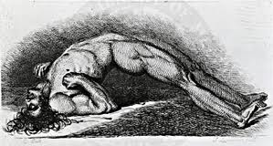
Tetanus: Symptoms
Lock jaw
Excessive muscle contractions and spasms
Drooling
Excessive sweating
Fever
Irritability
Difficulty swallowing
Uncontrolled urination and defecation
Notes:
Death by suffocation

Slide 17
Mercury
Infiltrates blood brain barrier
Common source is fish from contaminated waters (dumbing of industrial waste)
Air pollution (volcanoes, forest fires, burning of wastes containing mercury, burning coal)
Notes:
Brain is highly vascular and therefore very susceptible to mercury poisoning. Can be ingested or inhaled. When combined with other things, like cyanide… the life expectancy is short (10 days).

Slide 18
Mercury Toxicity
Sensory impairment
Lack of coordination
Peripheral neuropathy
Desquamatation (shedding of skin)
Emotional lability
Memory impairment
Insomnia
Notes:
Emotional instability… think Mad Hatter.

Slide 19
Aluminum
Sources?
Infiltrates the blood brain barrier
Impaired learning
Reduced motor coordination
Notes:
Sources… Just about everything.

Slide 20
Ethanol
Psychoactive drug
CNS depression
Decreased neurogenesis of hippocampus
Inflammation of the brain
Respiratory failure
Inhibits judgment

Slide 21
Blood Agents
Prevent the exchange of O₂ and CO₂between blood and body’s cells… cells suffocate.
Blood is bright red
Cause of Death: Respiratory Failure

Slide 22
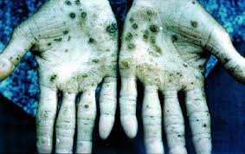
Arsenic
Pesticides
Semiconductor industry
Ground water
Faint garlic odor; detectable only at fatal concentrations.
Damages red blood cells (inhibits Oxygen delivery to muscles)
Headaches, confusion, severe diarrhea, drowsiness, convulsions

Slide 23
Arsenic Contamination Areas
http://upload.wikimedia.org/wikipedia/commons/5/57/Arsenic_contamination_areas.jpg

Slide 24
Cyanide
Cigarette smoke
Pesticides
Faint bitter almond odor
Interrupts energy production in mitochondria

Slide 25
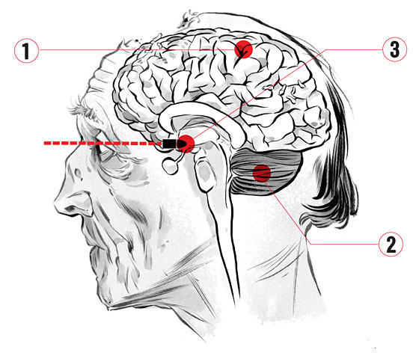
http://images.nymag.com/guides/everything/zombies/zombies111024_brain_560.jpg
Notes:
“Zombies have attention-locking problems. When they see something, they fixate. It resembles damage to the parietal lobe (1)—a condition called Bálint’s syndrome. So a zombie will fixate on you, but if you can distract it, it might lose track of you entirely. Zombies are stiff and have balance problems because of damage to the cerebellum (2). It’s the same way you feel when you’re really drunk—you’re suppressing the cerebellum too.” —Timothy Verstynen, Center for the Neural Basis of Cognition
“In a human, the brain stem, at the top of the spinal cord, is responsible for the core functions of life—respiration, heartbeat. But since zombies don’t breathe or have heartbeats, the core function of the zombie’s existence is controlled by the part of the brain that controls appetite: the hypothalamus (3). If you hit a zombie right between the eyes with enough force, you can go straight back horizontally into the hypothalamus.” —Bradley Voytek

Slide 26
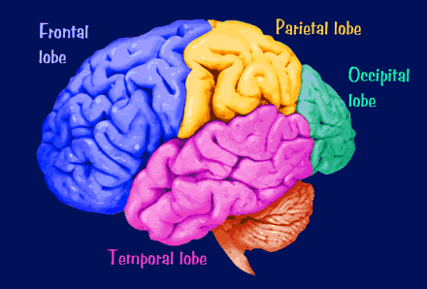
Control Center
Cerebellum
http://morphonix.com/software/education/science/brain/game/specimens/images/cerebral_cortex_lobes.gif

Slide 27
Frontal Lobe
Motor Cortex
Premotor Cortex:
Storage of motor patterns
Prefrontal Area:
Concentration
Elaboration of thought
Judgement
Inhibition
Personality
Emotional traits
Broca’s Area
Language production (Speech)
Cerebellum

Slide 28
Temporal Lobe
Hearing
Smell
Auditory association area
Expressed behavior
Receptive Speech
Memory/Information retrieval
Cerebellum

Slide 29
Parietal Lobe
Processing sensory input
Sensory discrimination
Integrates sensory information
from different modalities
Body orientation
Navigation
Cerebellum
Notes:
Damage to this part can cause something known as Balilint’s syndrome : Stroke or loss of blood flow to the area of the parietal and occipital lobe– causes you to visually fixate on something and not see the entire visual field.

Slide 30
Occipital Lobe
Reception and perception
of visual input
Cerebellum

Slide 31
Cerebellum
Cerebellum
Balance
Maintenance of muscle tone
Coordination of fine motor movement
Notes:
If damaged, fine motor skills become clumsy.

Slide 32
Brain Stem
Heart rate
Breathing
Swallowing, vomiting, coughing, sneezing,
Balance and coordination
Salivation and chewing
Visual reflexes
Regulation of general body movements
Sleep/wake cycle

Slide 33
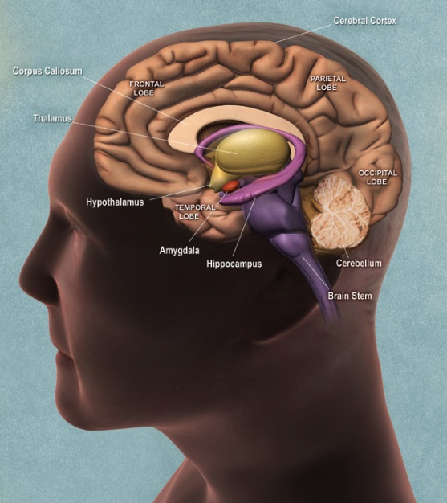
Limbic System
Dienchephalon
Thalamus
Hypothalamus
Amygdala
Hippocampus
Cingulate Gyrus
Ventromedial hypothalamus
Notes:
Thalamus – relay station; all sensations except smell, go through here up to cerebral cortex for processing
Hypothalamus – sleep wake cycle, growth hormones, bonding hormones…
Amygdala – memory, emotion and fear
Hippocampus – learning and memory
Cingulate gyrus highly influential in linking behavioral outcomes to motivation (e.g. a certain action induced a positive emotional response, which results in learning

Slide 34
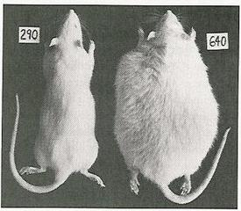
Damage to Ventromedial Hypothalamus
Notes:
Rat on Right has damaged ventromedial hypothalamus which causes excessive eating.

Slide 35
Limbic System
Thalamus | All sensations (except smell) go through this first (relay station) → cerebral cortex
Hypothalamus | Homeostasis, emotion, thirst, hunger, circadian rhythms, and control of the autonomic nervous system. Controls pituitary gland (growth, bonding, water balance).
Amygdala | Memory, emotion and fear
Hippocampus | Learning and memory. Converting short term memory to long term memory. Recalling spatial relationships in the world about us.

Slide 36
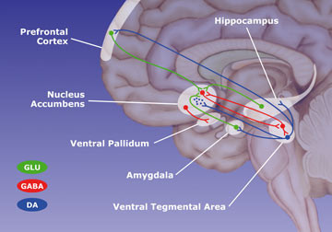
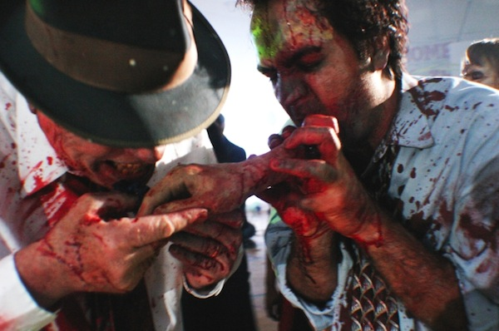
The Reward Circuit…
… and cannibalism
Notes:
Certain drugs like Cocaine or mephedrone (“bath salts”) hijacks your reward system… making the high even more profound. “Bath Salts (mephedrone)
Schitzophrenics have excessive amounts of dopamine; hallucinations, dellusions, paranoia, long-term memory issues, short attention span, lack of judgement, lack of desire to form relationships,

Slide 37
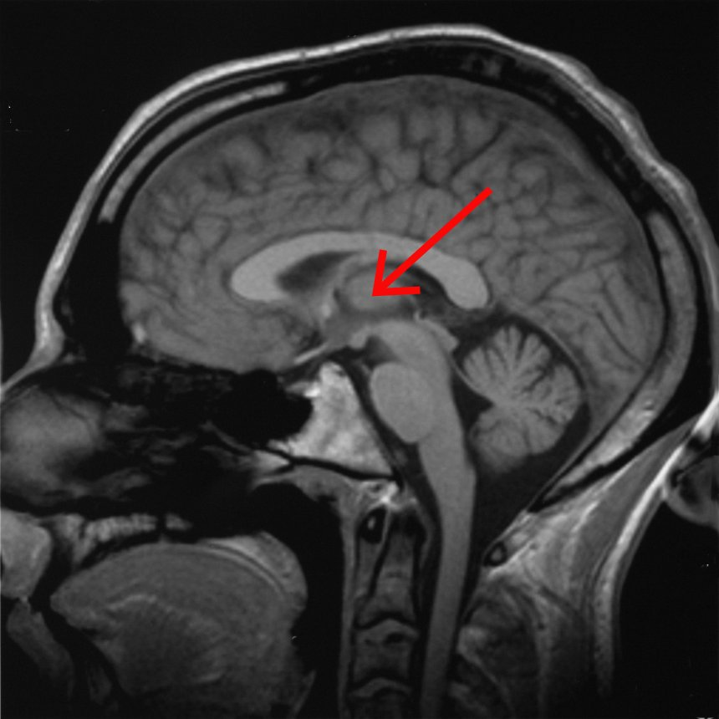
Zombies and Pain
Ventroposterior Hypothalamus
Notes:
Hypothalamus is responsible for: Homeostasis, emotion, thirst, hunger, circadian rhythms, and control of the autonomic nervous system – it could be that zombies experience pain – but don’t have an emotional charge to it… just like us and breathing. Or they could have actual neuropathy in their extremities due to nerve damage.

