Slide 1
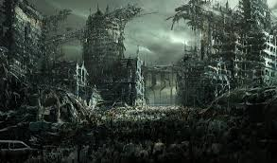
Zombie Apocalypse Then and Now

Slide 2
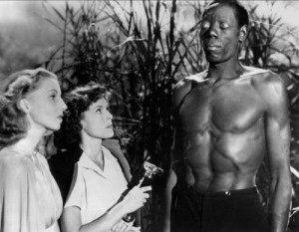
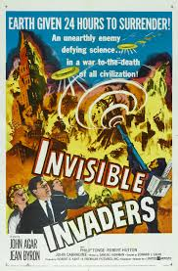
Different Time, Different Zombie
White Zombie:
Invisible Invaders:
Invisible aliens inhabit dead bodies
Notes:
White Zombie: A couple go to Haiti to be married. Visit a plantation owner who falls in love with the woman, convinces Bokor to turn her into a zombie so she will marry him. Other zombies are working the plantation. Bokor is evil, even the white man who wants to marry the woman turns good.
-racism
-fear of voodoo
-zombies are slaves made by bokor
Invisible Invaders (1959):
Invisible Aliens take over the bodies of the dead an demand that the earth surrender. When the earth does not surrender immediately, the aliens start invading dead bodies everywhere and making them cause general havoc: blowing up dams, causing fires and flooding, etc
-The aliens are determined to be radioactive

Slide 3
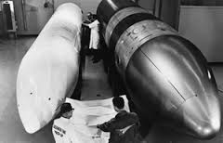
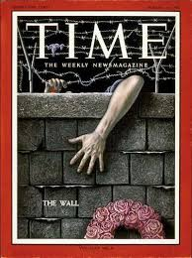
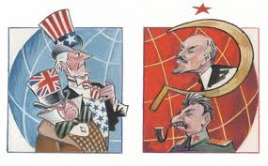
Notes:
-Cold War: tension between western world (U.S. and Nato) and the USSR. Both sides armed themselves heavily in preparation for nuclear war
-psychological war, technological competitions
-second red scare

Slide 4
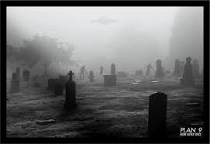
Plan 9 from Outer Space:
Apocalypse arises from humanity’s own hubris
Extraterrestrials resurrect the dead to stop humanity’s acquisition of dangerous weapons of mass destruction
Notes:
(1959) Movie: After atomic bombings of Hiroshima and Nagasaki (1945) (devastation of atomic age),new anxieties developed around technology and science, and the limitations of human progress.
Developments in science and technology, especially the desire to control nature through new forms of energy, lead extraterrestrials to intervene to stop humanity’s inevitable acquisition of these dangerous weapons of mass destruction.

Slide 5
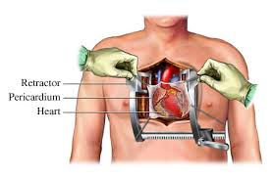
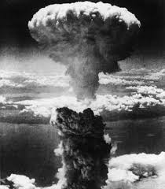
Notes:
-Nuclear bombs
-open heart surgery
-vaccinations
-What do all of these advances have in common?

Slide 6
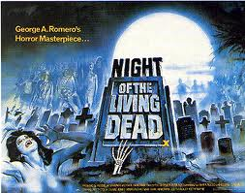
Human-Caused Zombie Invasions
Let sleeping corpses lie
Night of the Living Dead
Radiation emitted from a government “Venus probe” creates zombies
Insecticide machine brings zombies to life
Notes:
Night of the living dead: 1968
Let Sleeping corpses lie: 1974
Silent Spring: 1962

Slide 7
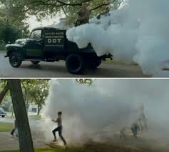
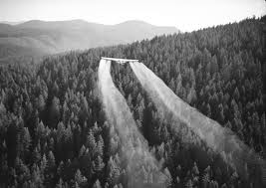

Slide 8
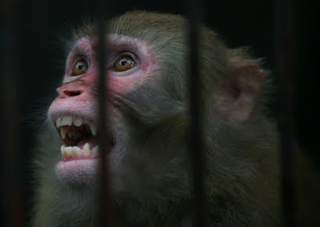
28 Days Later
Total apocalyptic scenario
Monkeys infected with “rage virus” for scientific testing
Animal Liberation activists free monkeys
Notes:
-2002 film, Opens with violent riots in London
-Animal Liberation Front

Slide 9
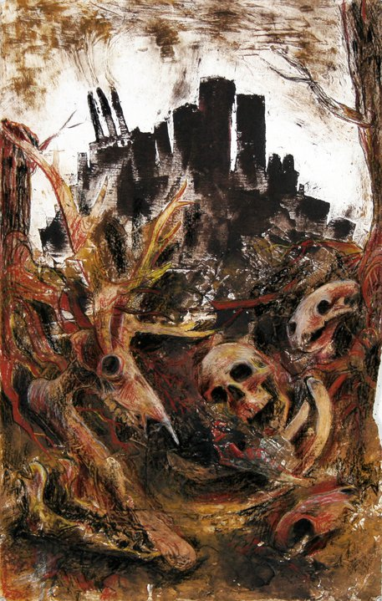
Causes of Zombies
Enslavement/Hypnosis
Technological Advances/Scientific Exploration
Environmental Destruction
Plague

Slide 10
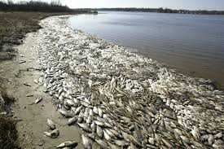
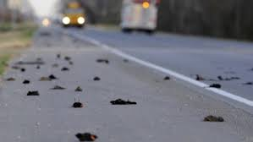
What’s In The News?
2013, Tens of thousands of dead fish wash ashore in South Carolina
2011, Thousands of birds drop dead in Louisiana and Arkansas

Slide 11
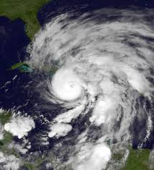
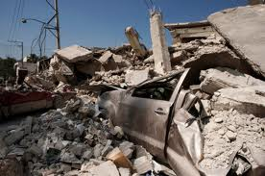
2012, Hurrican Sandy extends 1,000 miles wide
2013, Texas rocked by 16 earthquakes in 3 weeks --the last of which was one of the most powerful in 5 years.

Slide 12
Radioactive snow
Water on fire
2013, Double normal amount of radiation in Missouri snow
2011, 2012, 2013
Louisiana, North Dakota

Slide 13
Current water toxification in West Virginia: http://www.cbsnews.com/news/some-people-treated-for-water-related-issues-in-w-va/
Symptoms of exposure: nausea, vomiting, dizziness, diarrhea, rashes and reddened skin

Slide 14
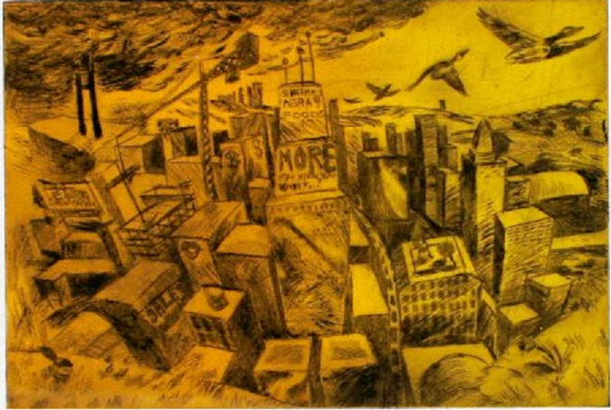
Could The Zombie Apocalypse
Be Starting Right Now?

Slide 15
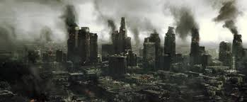
You Decide…
Split into groups of 6
Sam will assign research topic:
Plague
Slavery/Rebellions/Warfare
Environmental Catastrophe/Resource Scarcity
Technological Revolutions
Research Signs of Apocalypse
Report back findings to class

