Slide 1
Thermo-regulation
(How to keep your body cool or warm)

Slide 2
98.6 degree core temperature
Can loose/gain heat 5 ways:
Conduction
Convection
Radiation
Respiration
Evaporation

Slide 3
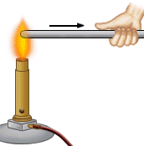
Conduction
The transfer of heat directly from one object to another.

Slide 4
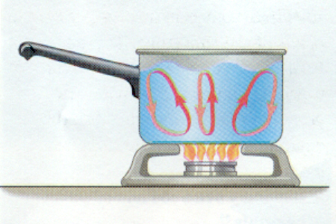
Convection
The transfer of heat through moving air or liquid.

Slide 5
Radiation
Heat is sent outward into the air from your body and into nearby colder objects.

Slide 6
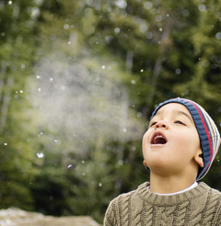
Respiration
When our body breaths in warm air and exhales carrying heat from the body

Slide 7
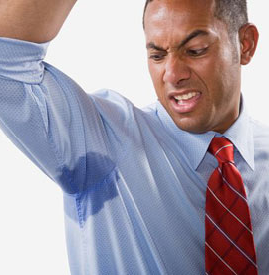
Evaporation
When a liquid changes into a gas.

Slide 8
Production of Heat at Rest vs. Activity
Body Area | Resting | Active
Brain | 16% | 3%
Chest/Abdomen | 56% | 22%
Skin/Muscles | 18% | 73%

Slide 9
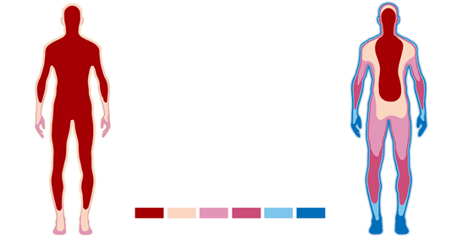
Heat loss

Slide 10
Factors in heat production
Food: Less than 40% of the energy produced by the conversion of food is used for the maintenance of body requirements.
Water: If you are dehydrated you cannot produce heat effectively.
Alcohol: Dilation of blood vessels in extremities (feel warmer but loose more heat).
Tobacco: Vasoconstrictor

Slide 11
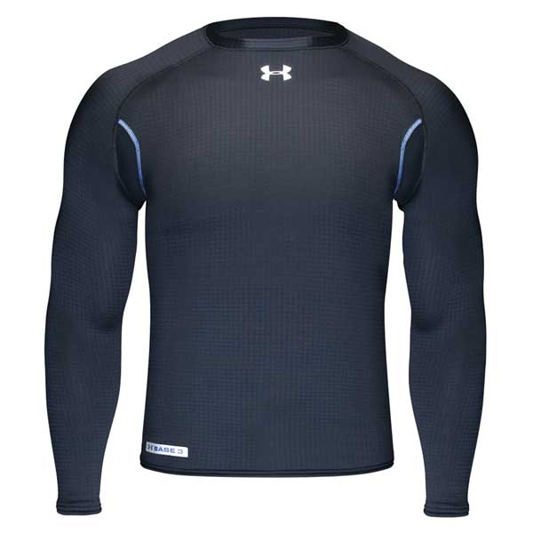
Clothing
Base layer: Keeps the skin dry by moving moisture to the outer layers. Inner hydrophilic outer hydrophobic. Polypropylene.

Slide 12
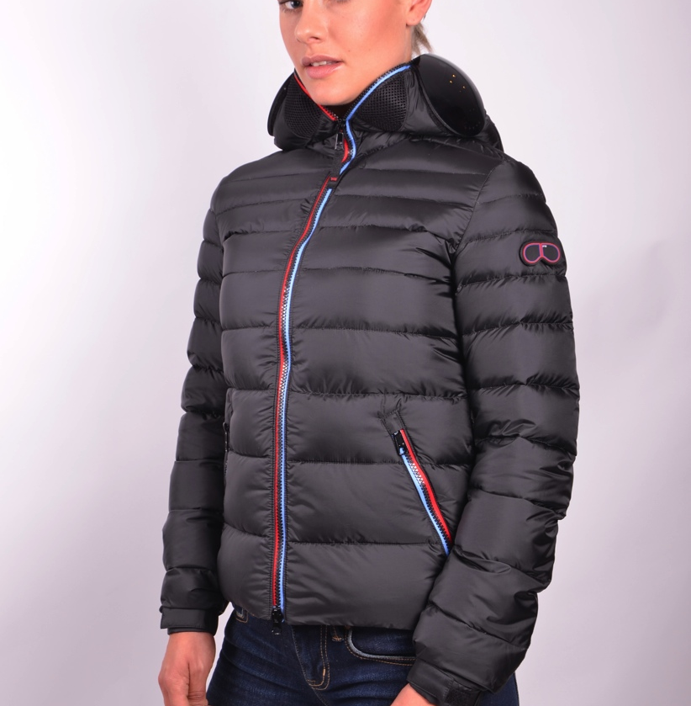
Insulation Layer
Insulation layer: Air is warm. Dead air. Convection cannot occur. Wool, down, polyester. COTTON IS ROTTEN!

Slide 13
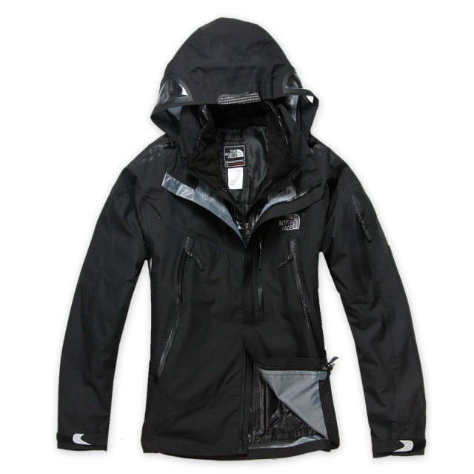
Outer layer
Outer layer: Wind shell, waterproof. BREATHABLE. Gore Tex, ect.

