Slide 1
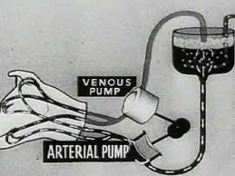
Experiments in the Revival of Organisms
-1940’s
-Soviet Research
-Mad Scientist (Doctor) Doctor Sergei Brukhonenko.
Notes:
https://www.youtube.com/watch?v=RAokidlg_MM&oref=https%3A%2F%2Fwww.youtube.com%2Fwatch%3Fv%3DRAokidlg_MM&has_verified=1

Slide 2
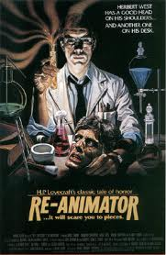
Herbert West Re-Animator
Story: H.P. Lovecraft 1922
Mad scientists reanimates the dead
Film: 1985

Slide 3
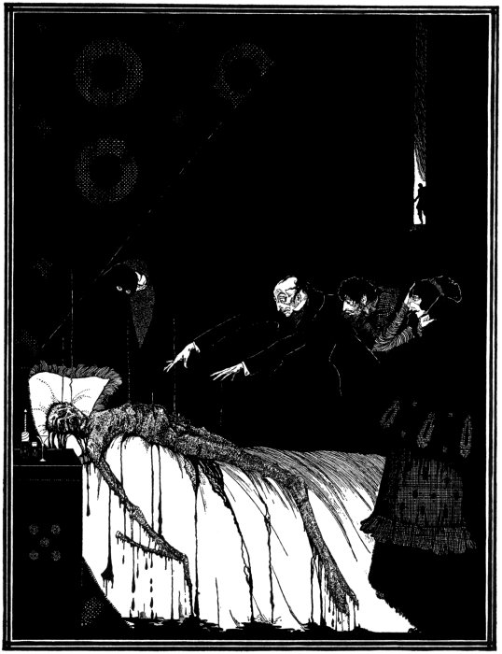
The Facts In The Case of M. Valdemar
Edgar Allen Poe
1845
Hypnotist suspends death

Slide 4
BBC News: Will We Ever Bring The Dead Back To Life?
“When you’re freshly dead, your brain isn’t necessarily irreversibly, irrefutably damaged yet”
-Death occurs more on a sliding scale than at a single moment
“At this point we’ve got two domains: the slightly dead and the very dead, for lack of better terms,” says Abella. “Or the not-quite-dead-yet. It’s definitely getting blurry.”
Notes:
http://www.bbc.com/future/story/20131031-will-we-ever-bring-the-dead-back

