Slide 1
The Psychology of Survival

Slide 2
Hawke’s Special Forces Survival Handbook:
Survival Situations:
“It happens to thousands of people every year, and it could just as easily happen to you. Your airplane goes down in the wilderness; or the train you’re riding derails miles from the nearest junction…the possibilities are endless.”
Will you be able to handle the situation?

Slide 3
Always Be Prepared
Have on hand:
Clothing layers
Knife
Compass
Learn how to:
Start a fire
Create shelter
Never:
Lose core temp.
Lose hope
Notes:
Attitude can make a huge difference in survival situations but never underestimate the importance of preparation.

Slide 4
Once You’re Up The Creek…
Danger: Remove yourself from an immediately dangerous environment
Assess: Tend to any life threatening wounds (yourself and others)
Prioritize: Assess the situation and prioritize the SWFF constants (shelter, water, fire, food)
Reality: Decide to stay or go

Slide 5
RULE NUMBER ONE:
NEVER QUIT!
“I will do everything and anything it takes to stay alive and to keep going with very ounce of my physical and spiritual energy, until I get back home and into the hearts of the ones I love”

Slide 6
RULE NUMBER TWO:
HAVE A SENSE OF HUMOR
“It would be pretty funny to survive a plane crash or boat sinking, and then die from lack of food or water”
MURPHEY’S LAW:
If anything can go wrong, it will go wrong.
As applied to survival: If we’re ready for something, it won’t happen; and if you aren’t ready, it will happen!

Slide 7
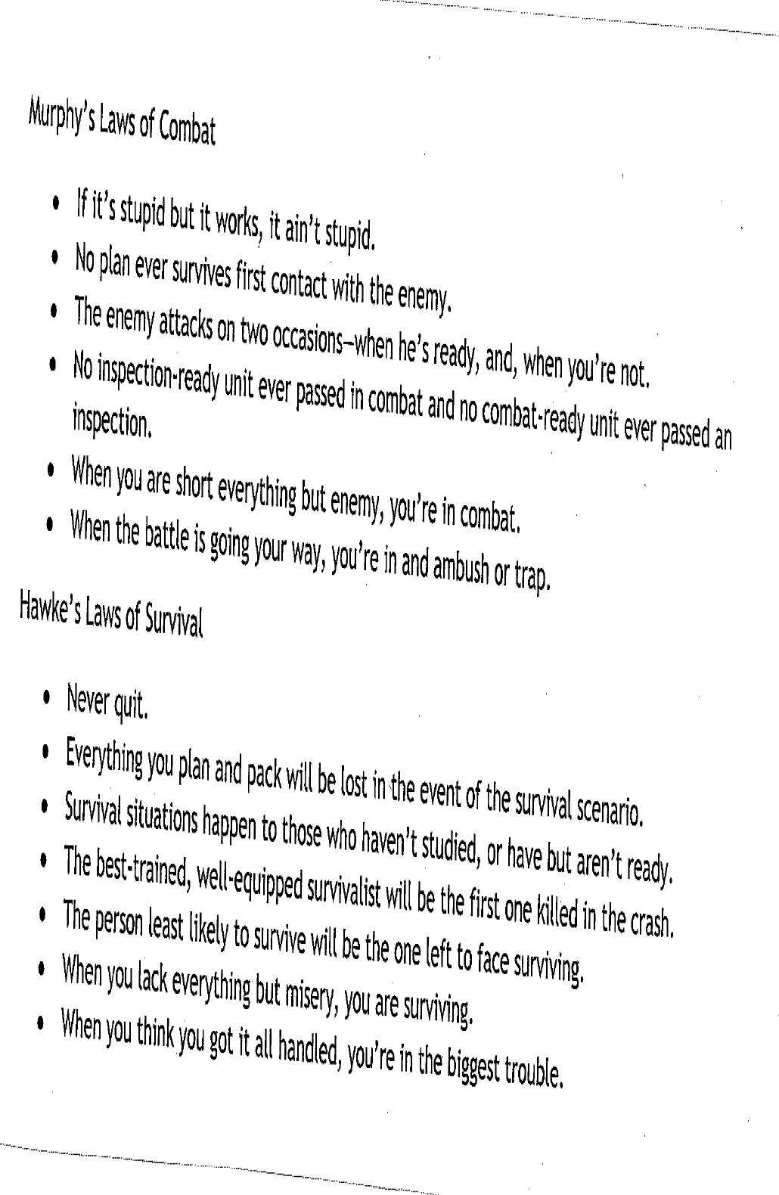

Slide 8
RULE NUMBER THREE:
EXPECT NOTHING
-Do not expect anything to go your way
Ex: Do not expect to be rescued, you will only be let down if it doesn’t come to pass as soon as you think
-Always hope, but don’t hold expectations
-Live in the moment

Slide 9
“William told me of his neighbor and how he was bitten. He swore it didn’t take more than a few hours for him to succumb to the wound and turn. It only takes one of them. I read somewhere that even the best thieves concede to the fact that they will get caught eventually, it’s just the law of averages. Basing my chances of survival on this premise, I too feel that my day will come. All I can do is attempt to survive.”
-J.L. Bourne: Day by Day Armageddon

Slide 10
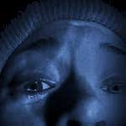
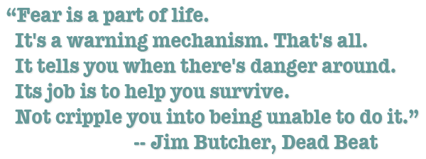
RULE NUMBER FOUR:
DON’T LET FEAR SET IN
Fear is your worst enemy
Most fear is a result of ignorance, or the unknown
Combat fear by:
-keeping yourself busy
-learning hard skills and feeling confident: knives are number on survival skill

