Slide 1
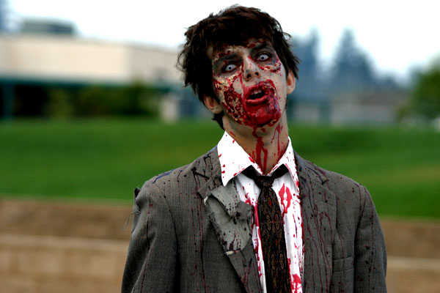
Class 1 Outbreak
Low-level
Third world countries
Rural first world
1-24 zombies
24 hours to 14 days
Media “Homicides” or “Accidents”

Slide 2
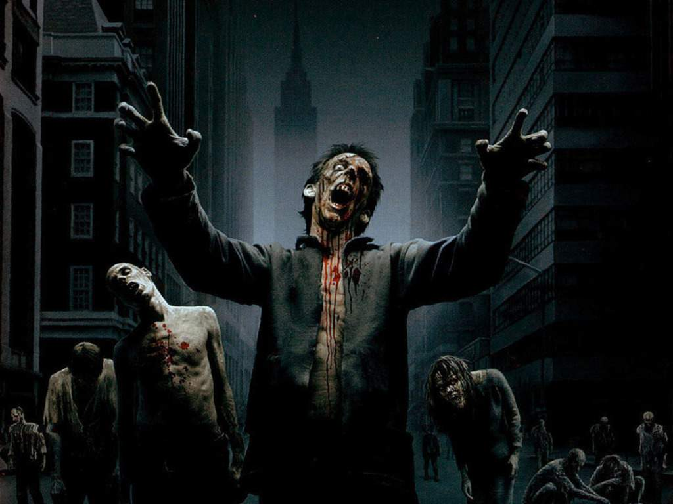
Class 2 Outbreak
Urban or densely populated rural
20-100 Zombies
Same duration, more casualties
Low-Level military response
Media coverage

Slide 3
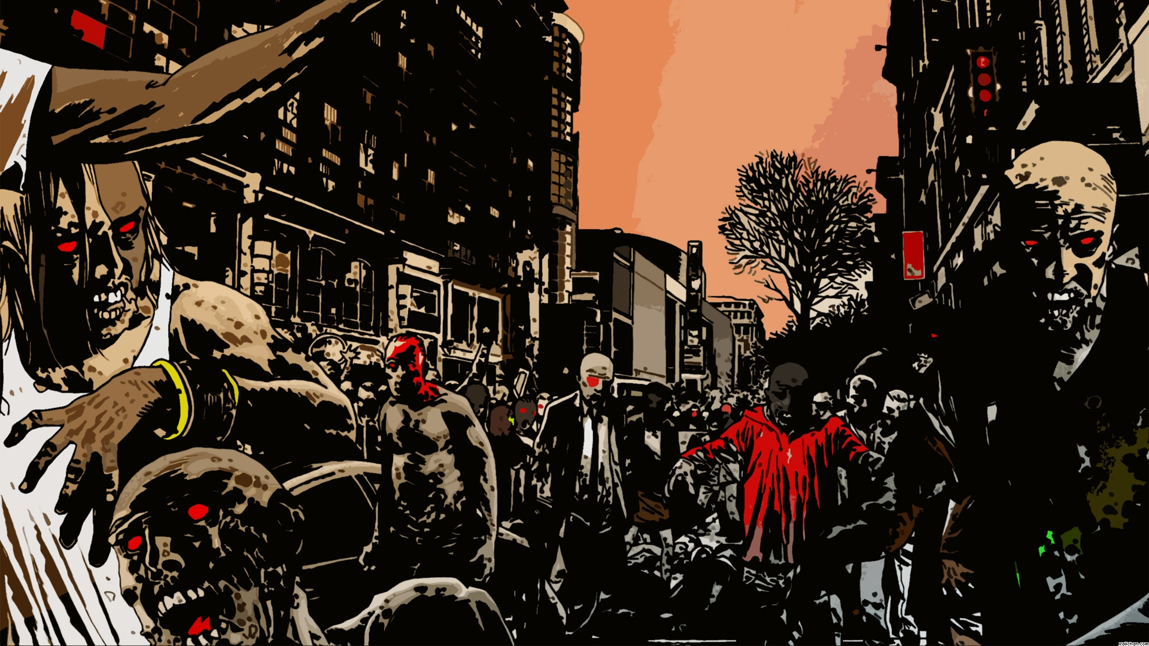
Class 3 Outbreak
Thousands of zombies
Several Months
Regular Military
Martial Law
Riots/Looting

Slide 4
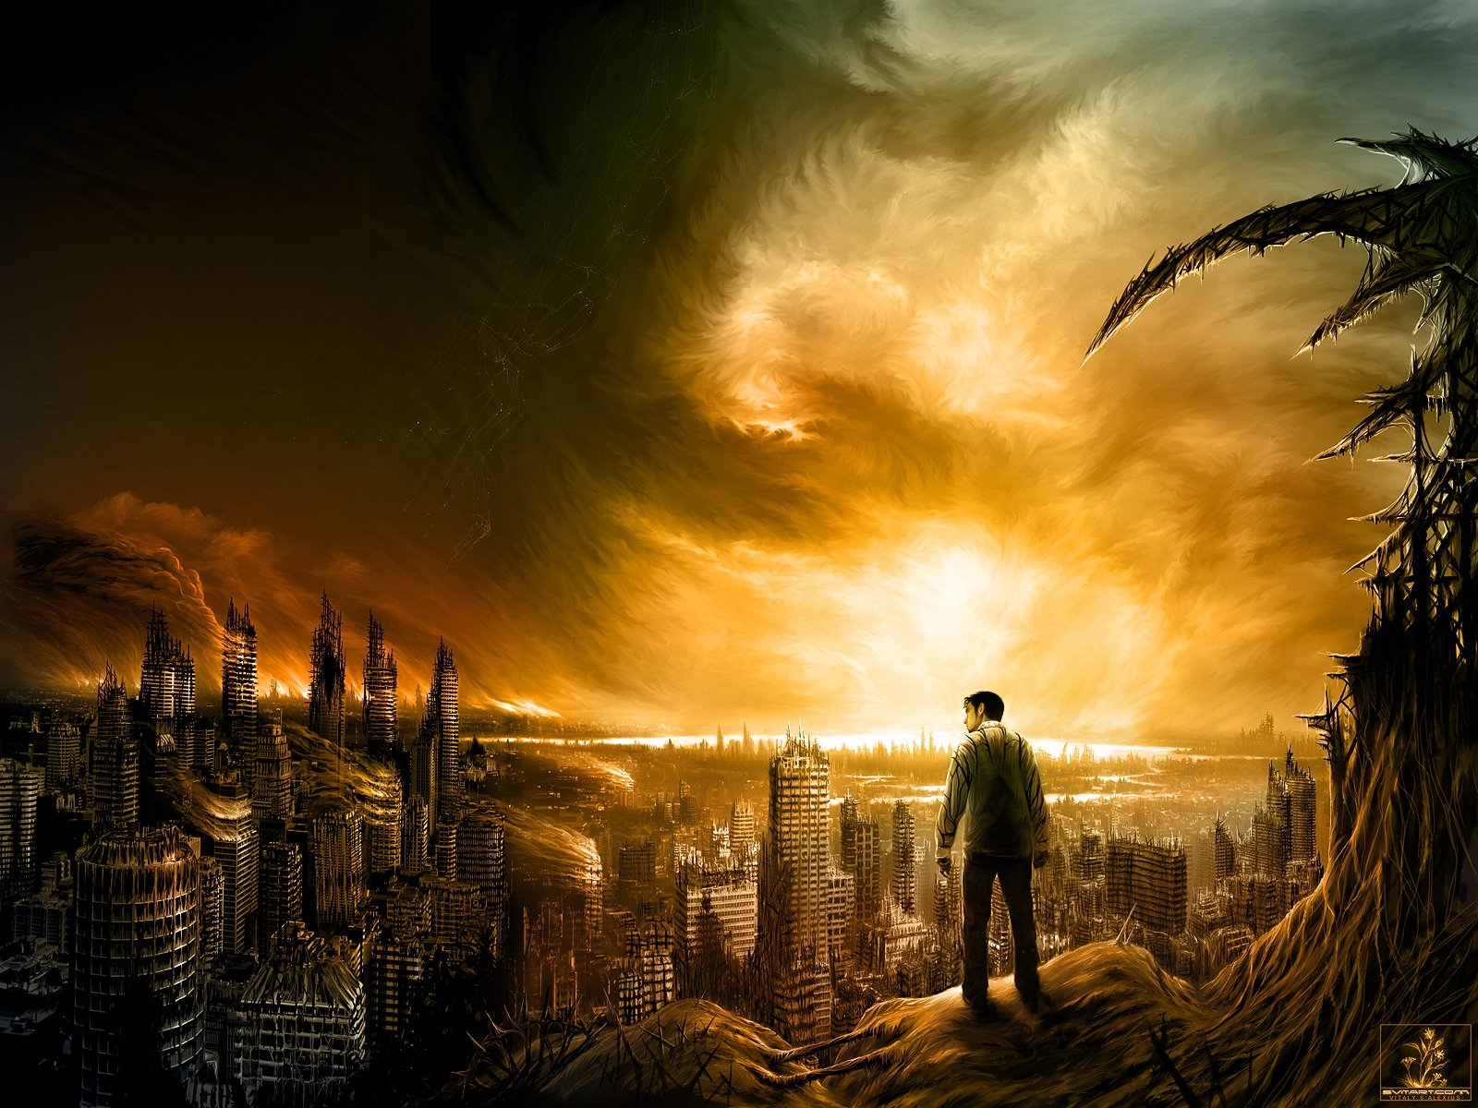
Class 4: The Apocalypse
Society collapsed
Zombies take over planet
Small bands of individuals take charge
Machines break down
Must survive zombies and humans

Slide 5
Detection
Homicides head shots
Missing persons
Cases of “Violent Insanity”
Riots without provocation
Disease based deaths
Media blackout of above

