Slide 1
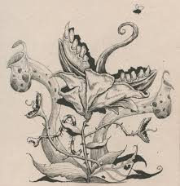
Plant Zombies
A Real Concern

Slide 2
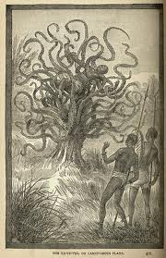
Legends & Lore
1874, Edmund Spencer writes literary fiction about man-eating tree for the New York World
Explorer encounters a human sacrifice by “Mkodo” tribe of Madagascar
“The slender delicate palpi, with the fury of starved serpents, quivered a moment over her head, then as if instinct with demoniac intelligence fastened upon her in sudden coils round and round her neck and arms; then while her awful screams and yet more awful laughter rose wildly to be instantly strangled down again into a gurgling moan, the tendrils one after another, like great green serpents, with brutal energy and infernal rapidity, rose, retracted themselves, and wrapped her about in fold after fold, ever tightening with cruel swiftness and savage tenacity of anacondas fastening upon their prey.”
Notes:
Carnivorous tree consumes a young woman

Slide 3
Nubian Tree
Phil Robinson, "Under the Punkah," (1881)
“This awful plant, that rears its splendid death-shade in the central solitude of a Nubian fern forest, sickens by its unwholesome humours all vegetation from its immediate vicinity, and feeds upon the wild beasts that, in the terror of the chase, or the heat of noon, seek the thick shelter of its boughs ; upon the birds that, flitting across the open space, come within the charmed circle of its power, or innocently refresh themselves from the cups of its great waxen flowers ; upon even man himself when, an infrequent prey, the savage seeks its asylum in the storm, or turns from the harsh foot-wounding sword-grass of the glade, to pluck the wondrous fruit that hang plumb down among the wondrous foliage. And such fruit ! Glorious golden ovals, great honey drops, swelling by their own weight into pear-shaped translucencies. The foliage glistens with a strange dew, that all day long drips on to the ground below, nurturing a rank growth of grasses, which shoot up in places so high that their spikes of fierce blood-fed green show far up among the deep-tinted foliage of the terrible tree, and, like a jealous body-guard, keep concealed the fearful secret of the charnel-house within, and draw round the black roots of the murderous plant a decent screen of living green”
Notes:
Describes ‘uncles’ travels…The story continues in describing how the tree captured and ate one of the uncle's native companions, and how the uncle proceeded to shoot at the tree. When his ammunition was finally exhausted, the uncle continued his work using a knife to destroy the tree, as the tree fought back with its blood-sucking leaves, and entangling limbs.

Slide 4
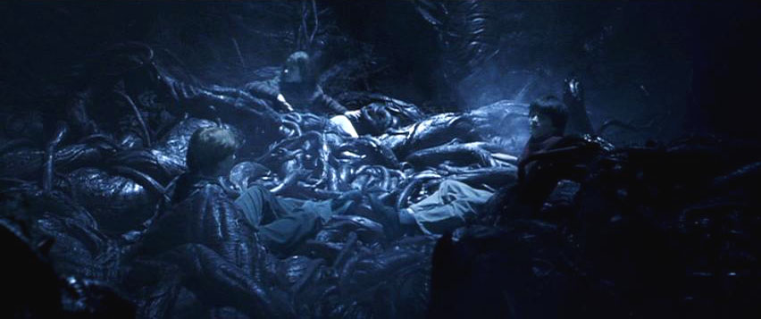
Devils Snare/Vampire Vine
William Thomas publishes an article in Review of Reviews
Plant could “drain the blood of any living thing which comes within its death-dealing touch."

Slide 5
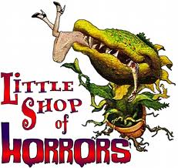
Comedy, horror, rock musical
Sometimes little window plants need human blood to survive!
Notes:
https://www.youtube.com/watch?v=I3qiMfiAH98
https://www.youtube.com/watch?v=L7SkrYF8lCU

Slide 6
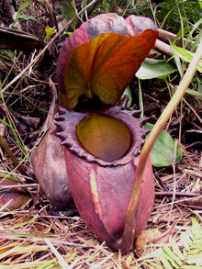
In All Reality…
Largest Carnivorous Plant: Nepenthes rajah
-Native to Malaysia
-Usually eats insects
-Sometimes can eat small mammals

Slide 7
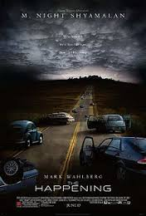
The Happening
Neurotoxin in the air caused anyone exposed to commit suicide
Humans have become a threat to the planet
Plants emit neurotoxins for self preservation

Slide 8
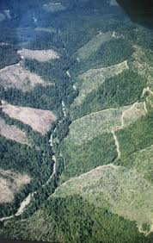
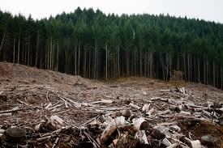
Humans Are Destroying the Natural World

Slide 9
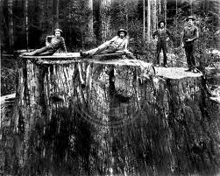
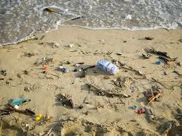
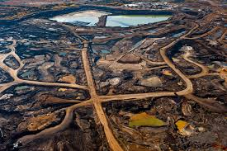
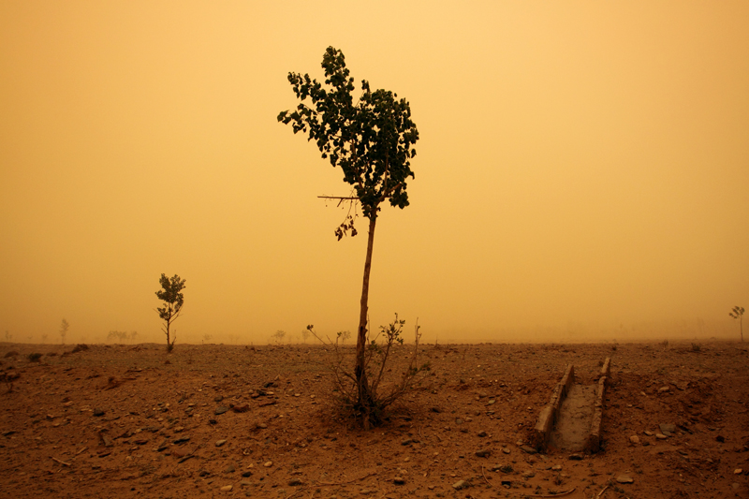
Forests precede us and deserts dog our heels

Slide 11
What If Plants Fought Back?

Slide 12
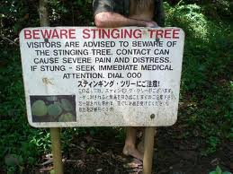
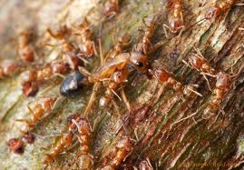
Plants Do Fight Back
Stinging Tree of Australia
AKA Gympie Gympie
Cecropia trees and Azteca ants defensive partnership
Notes:
Stringing Tree: covered in countless microscopic hairs, all of which are loaded with an incredibly potent neurotoxin. The hollow hairs get easily stuck in skin on contact and deliver the neurotoxin, which causes intolerable pain and, sometimes, death.
Pain is apparently akin to being burned alive while being stabbed and can apparently last for months after the initial sting

Slide 13
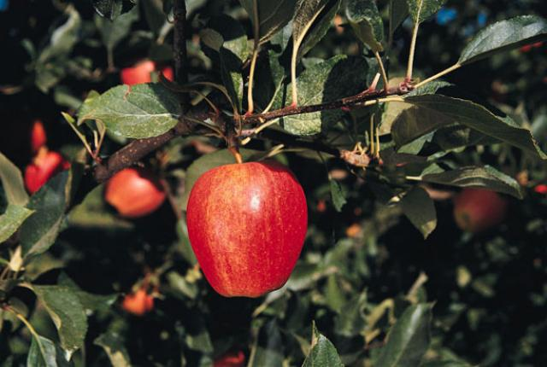
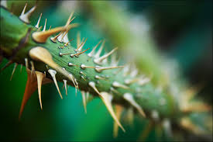
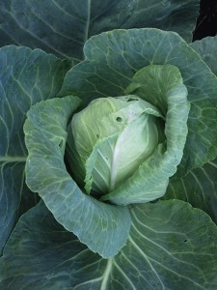
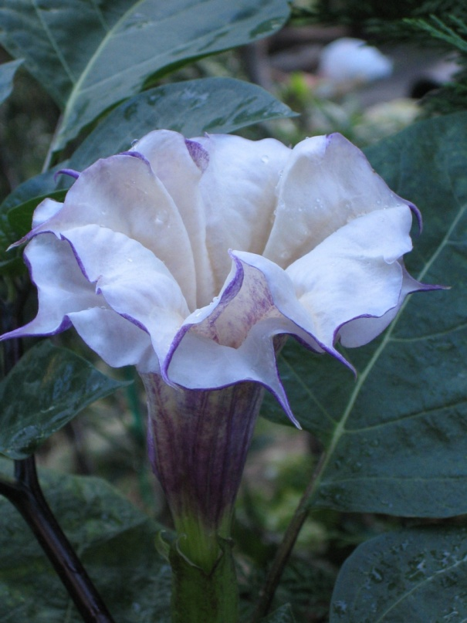
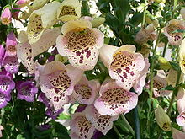
Notes:
Thorns:
Cyanide:
Foxglove: It contains cardiac glycosides that increases contractions of the heart resulting in heart failure. Symptoms that can occur after ingestion include dizziness, vomiting, irregular heartbeat and/or hallucinations.
Datura: hallucinogen, often toxic for people who don’t know what they’re doing
Cabbage:When a cabbage leaf is cut or eaten by a predator, the cabbage will emit a gas—methyl jasmonate. This gas sends a signal to the cabbages around it. When the signal is received, the nearby cabbages exude toxic chemicals in their leafs to ward off the potential predator that is noshing on the cabbages. - See more at: http://www.garden.harvard.edu/?p=1789#sthash.YClUiZMR.dpuf
How else do plants fight back?
Considering the reality of ecological disaster and plant’s ability to defend themselves from predators, do you think a scenario like the one in the happening could be possible?

