Slide 1
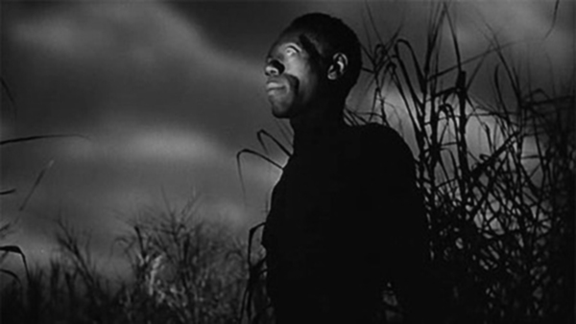
The Case of Haitian “Zombis”

Slide 2
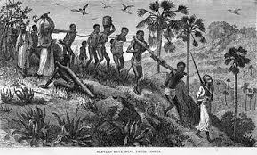
History of the Haitians
-Haitian people came from the Yuroba of Nigeria, Benin and Togo
-Enslavement by French colonialists in 18th century
-Relocated to Hispanola

Slide 3
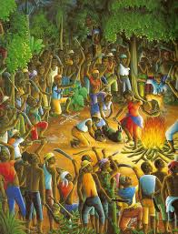
Haitian Vodou
-Forced conversion to Christianity
-Slaves practiced Vodou in secret
-Bokors: priests, served the gods
-Could be hired to perform sorcery
-Performed both good and bad magic
-Looked down upon dishonor and greed
-Vodou played role in Haitian Revolution
- 1791 Bois Caiman revolt
Notes:
Slaves forced to convert to Christianity
Fusion of African vodou with western influences: Christianity, European mysticism
Religion: Unreachable God (Bondye)
Lesser entities: Loa-guardian of crossroads, guardian of agriculture, spirit of love, etc
Bokor (human priests) serve the Loa, are hired to perform sorcery
-can do both good and bad magic
-Haiti became first black people’s republic: 1791 Bois Caiman revolt/vodou ceremony

Slide 4
Origin of Haitian “Zombis”
-Bokors create zombis
-A form of punishment for:
-tattletales
-general nuisances
-those who have unpaid debts
-those who have committed unpaid for crimes
https://www.youtube.com/watch?v=no5YpWlEFws
Notes:
Video: 11:30-16:45

Slide 5
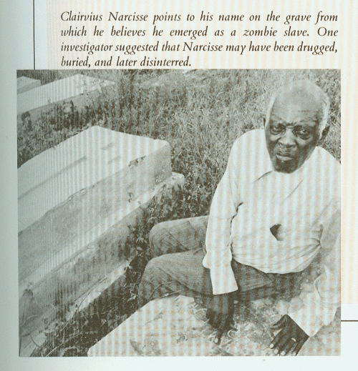
Case Study 1:
Clairvius Narcisse
-Initial symptoms:
-fever, breathing problems, crawling skin
-1962, Declared dead, buried
-1981, approaches sister alive
Clairvius’s story:
-Was alive when buried
-Dug up from grave and made a slave on a plantation under mind control
-Become free when another slave killed master
-Thinks his brother hired a Bakur to zombify him because of a property dispute

Slide 6
Case Study 2
Professor and a doctor carried out case studies on three reportedly zombified people:
“WD is a slightly built man, constantly scowling…He spent most of his time sitting or lying in a characteristic position, lower limbs to the left, upper limbs to the right, rarely speaking spontaneously and only in single words which were normal in form and content. He could not describe his period of burial or enslavement but agreed he malad (ill) and a zombi. He could be persuaded to walk with normal posture and gait, steadily but slowly…His eyes scanned around him with clear intent, his hands picking aimlessly at his nails or at the ground, and he avoided eye contact.”
Notes:
Professor Roland Littlewood of the Departments of Anthropology and Psychiatry and Chavannes Douyon, a doctor carried out case studies on three reportedly zombified people, and published their findings in The Lancet in 1997

Slide 7
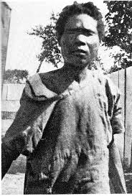
Case Study 3: Zora Neale Hurston’s Zombie Account
1938 Zora Neale Hurston writes about zombis in her book “Tell my Horse”
https://www.youtube.com/watch?v=YmKPjh5RX6c

Slide 8
“I had the rare opportunity to see and touch an authentic case. I listened to the broken noises in its throat.... If I had not experienced all of this in the strong sunlight of a hospital yard, I might have come away from Haiti interested but doubtful. But I saw this case of Felicia Felix-Mentor which was vouched for by the highest authority. So I know that there are Zombies in Haiti. People have been called back from the dead.”
“The sight was dreadful. That blank face with the dead eyes. The eyelids were white all around the eyes as if they had been burned with acid.... There was nothing you could say to her or get from her except by looking at her, and the sight of this wreckage was too much to endure for long.”

Slide 9
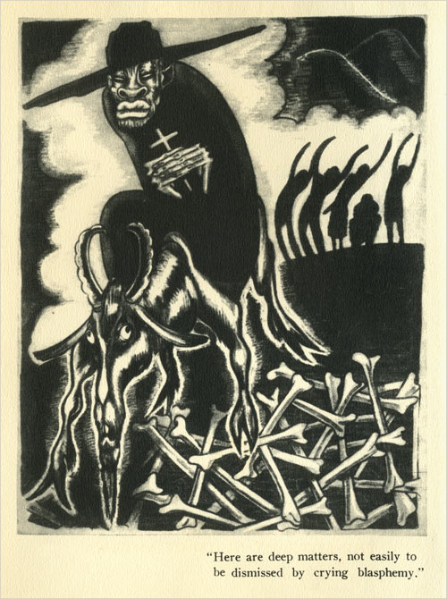
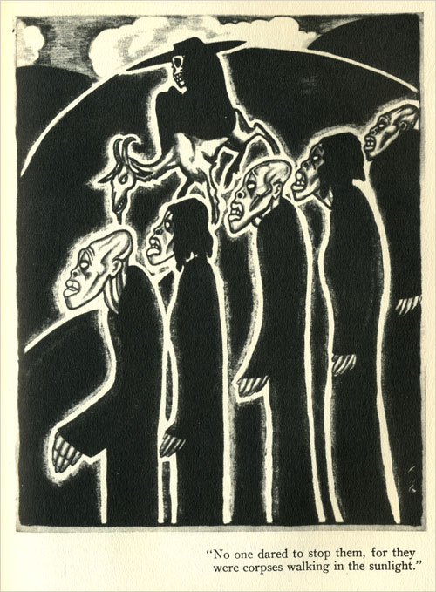
Magic Island- B. Seabrook
1929, Introduced “zombi” into U.S. speech
Narrator encounters vodou cults in Haiti and experiences their resurrected hordes

Slide 10
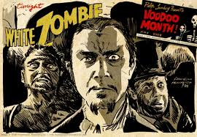
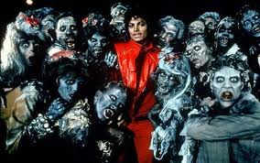
White Zombie
Film 1932
Thriller
Michael Jackson Music Video
1983

Slide 11
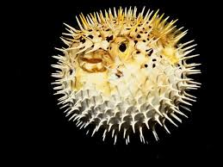
So How Does it Work?
https://www.youtube.com/watch?v=no5YpWlEFws
Toxic poison induces death-like state:
Compound inside pufferfish: Tetrodotoxin
Datura
Hypnosis
Cultural Norms/Accepted Beliefs
Notes:
16:45-19:55

Slide 12
Zombies Are Real!
In Haiti, zombification is legally considered murder
Article 246 of the Haitian penal code:
“It shall also be qualified as attempted murder the employment which may be made against any person of substances which, without causing actual death, produce a lethargic coma more or less prolonged. If, after the person had been buried, the act shall be considered murder no matter what result follows.”
Up to a thousand new cases of zombification are reported every year!

Slide 13
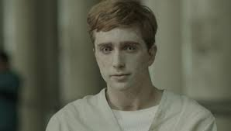
Writing Prompt
Create a case study about a time you have come into contact with someone who seemed zombi-esque
What were their symptoms?
Did they seem threatening?
What do you think was the cause?

