Slide 1
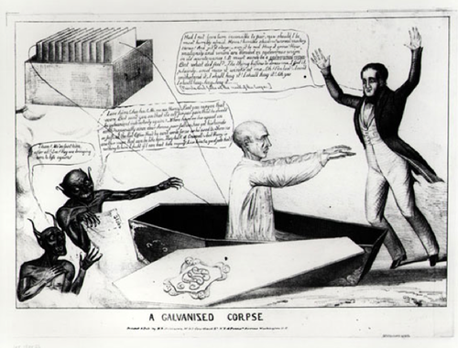
Galvanism: Raising the Dead with Science (Almost)

Slide 2
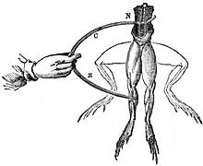
Luigi Galvani discovers animal electricity
-galvanism: the contraction of muscle stimulated by an electric current
-electricity & animation
-Aka bioelectricity/
electrophysiology
Notes:
Bioelectricity: the interaction between electromagnetic fields and biological entities
Galvani was slowly skinning a frog at a table where he had been conducting experiments with static electricity by rubbing frog skin. Galvani's assistant touched an exposed sciatic nerve of the frog with a metal scalpel, which had picked up a charge. At that moment, they saw sparks and the dead frog's leg kicked as if in life. The observation made Galvani the first investigator to appreciate the relationship between electricity and animation — or life.

Slide 3
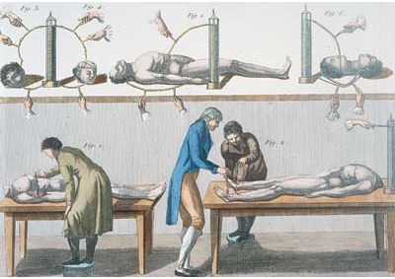
Giovanni Aldini Resurrects the Dead
-1803, Experiments with galvanism on the severed heads of executed malefactors executed

Slide 4
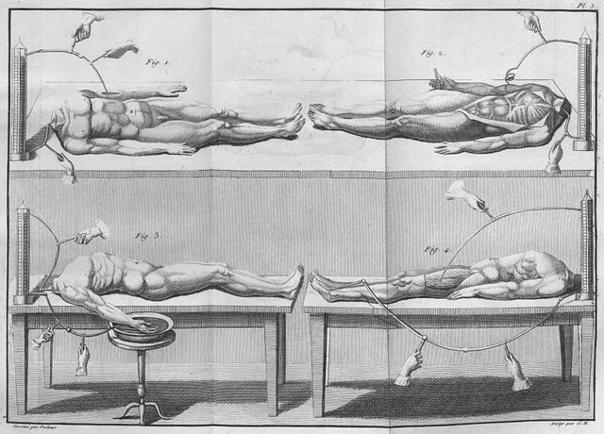
George Forster was hung at 8am on 18th January 1803 at Newgate Prison, for the drowning of his wife and youngest child in the Paddington Canal. After hanging for an hour in sub-zero temperatures, Aldini procured the body and began his galvanic experiments.

Slide 5
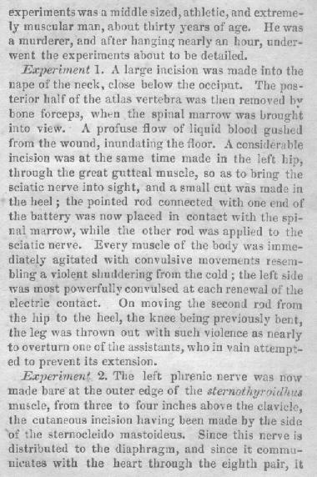
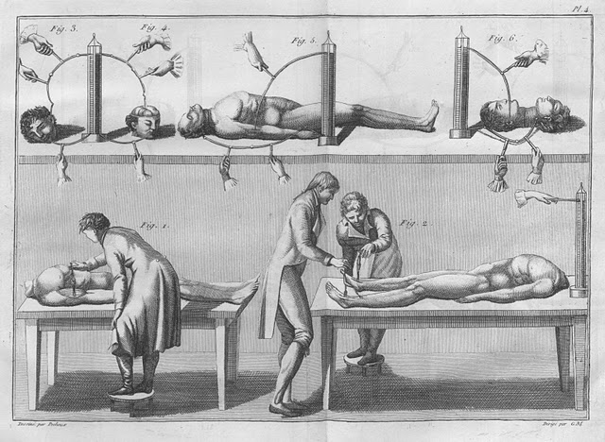

Slide 6
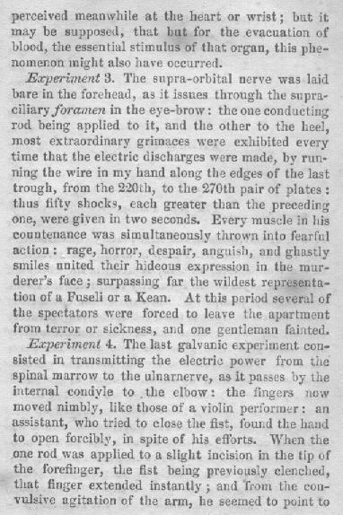
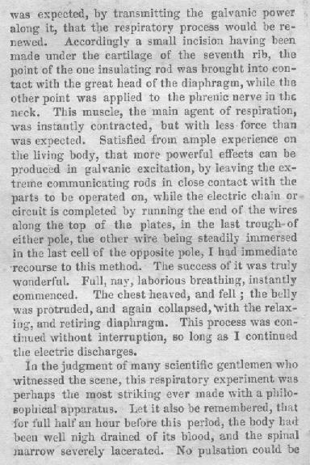

Slide 7
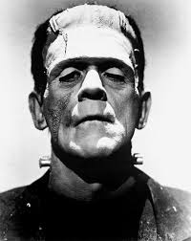
Frankenstein:
The Modern Prometheus
Notes:
1831
Greek mythology: culture hero, and trickster figure who is credited with the creation of man from clay, and who defies the gods and gives fire to humanity, an act that enabled progress and civilization.
https://www.youtube.com/watch?v=8H3dFh6GA-A

Slide 8
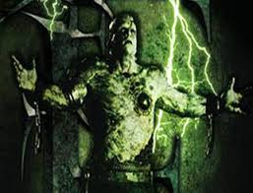
Writing Prompt:
If you could give life back to the dead, would you?
Consider the moral and practical implications when deciding on your answer.

