Slide 1
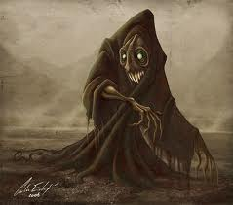
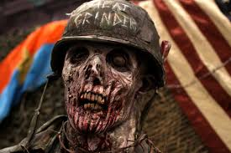
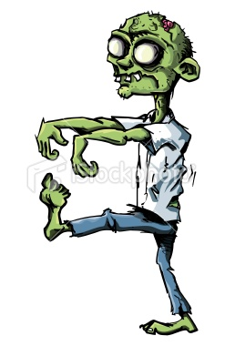
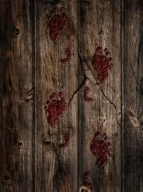
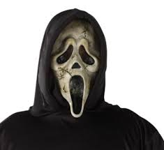
What do you think about when you think of zombies?

Slide 2
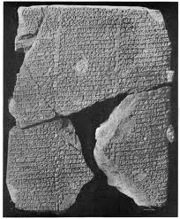
Epic of Gilgamesh
-The oldest known human story, dating 18th century B.C.
-Ancient Mesopotamia
“I will knock down the Gates of the Netherworld, I will smash the door posts, and leave the doors flat down, and will let the dead go up to eat the living! And the dead will outnumber the living!” -Ishtar, the goddess of love and war

Slide 3
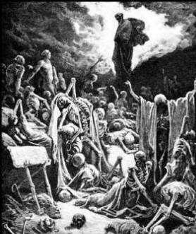
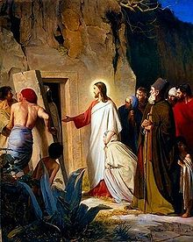
Bible-New Testament
Ezekiel: God and Ezekiel raise an army of dead bodies
Jesus raises Lazarus from the dead

Slide 4
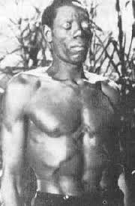
Haitian Voo-Doo Zombie
-Earliest mention of the world “zombi”
-Stems from Voo-Doo practice
-Zombie remains alive, type of hypnosis

Slide 5
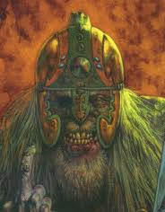
Draugr
-Norse/Germanic Mythology
-Literally “one who walks after death”
-Oftentimes appears as the corpse of a warrior

Slide 6
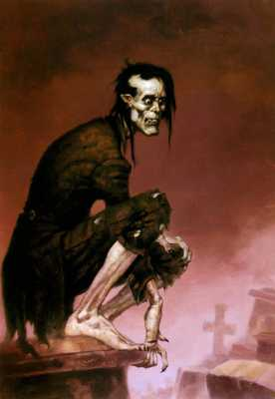
Arabian Ghoul
-In Arabic, literally a demon
-Dwells in graveyards
-Cannibalistic

Slide 7
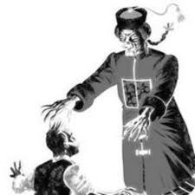
Jiang Shi
-Chinese folklore and legend
-Reanimated corpse also known as the Chinese “hopping zombie”
-Dressed officially

Slide 8
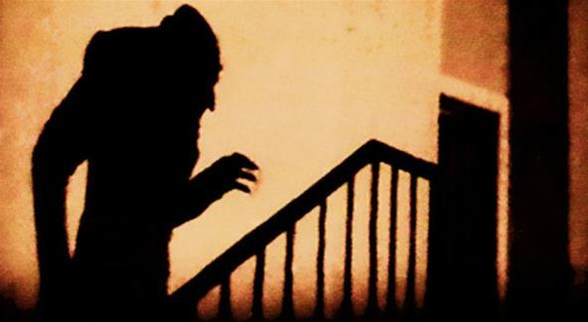
Revenant
-Western European ghost or animated corpse
-Believed to return from the dead to haunt, or seek revenge from the living
-”Revenant” derived from Latin word “revaneniens” meaning “returning”

Slide 9
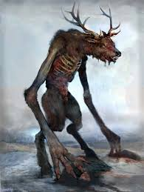
Wendigo
-Native American
-Also known as “skin walkers”
-Cannibalistic, very greedy

Slide 10
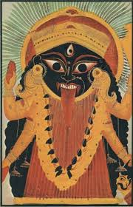
Vetala
-Hindu mythology
Ghost-like being, defined as spirits inhabiting corpses
May be used as vehicles for movement but may also leave the body at will.

Slide 11
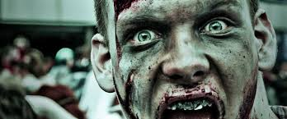
Virus Zombie
-Modern zombie
-Spreadable by physical contact or body fluids
-Fast moving, very hungry

Slide 12
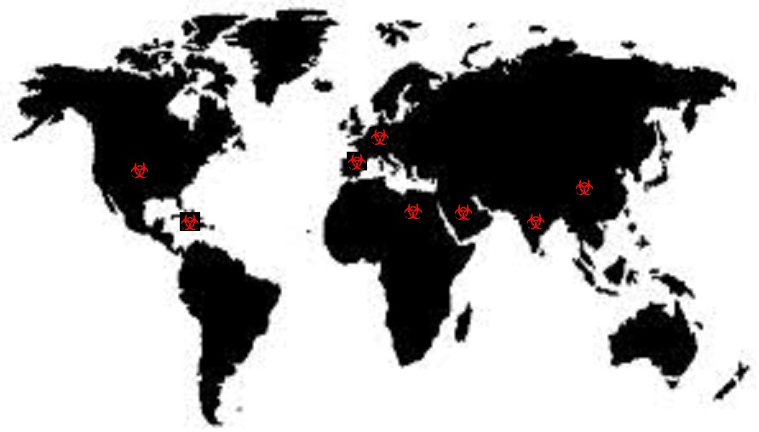
Map of Zombie Legends

Slide 13
Virus Zombie
Jiang Shi
Wendigo
Draugr
Haitian Zombie
Arabian Ghoul
Vetala
Revenant

